Slide 1
Wireline Log Analysis

Slide 2
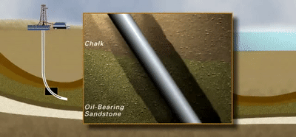
Wireline Logging Tool

Slide 3

Importance Of Logging
Oil wells are not guaranteed to have oil
Single well costs $5 millions for drilling and casing
Well logging is the only hope to get the $5 million back

Slide 4
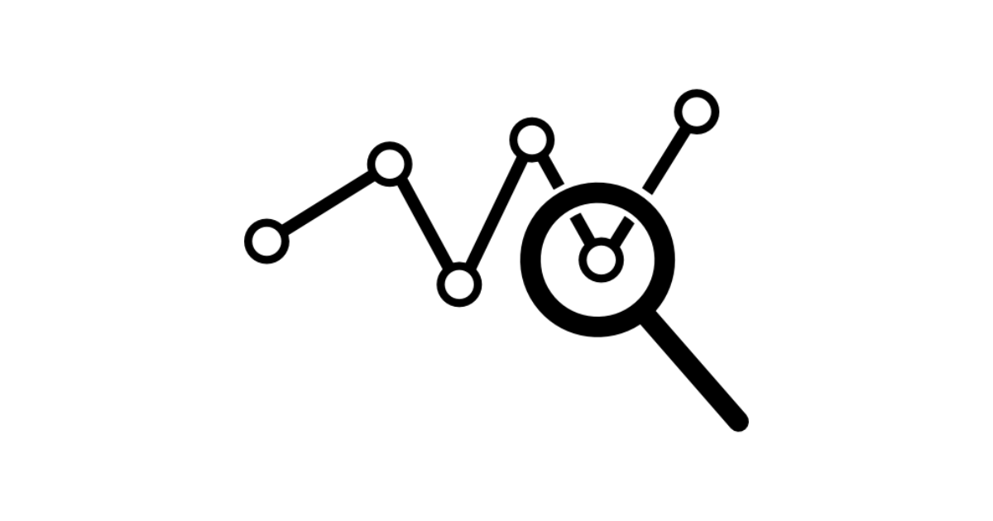
Log Columns
Wireline Logging Tools vary but mainly measure:
Resistivity (ohm/m)
Neutron Porosity (m³/m³ = %)
Gamma Rays (API = American Petroleum Institute unit)
Self Potential (Volt)
Depth (m.)
Caliper (Inch)
Sonic Waves (us./ft.)
And many more

Slide 5
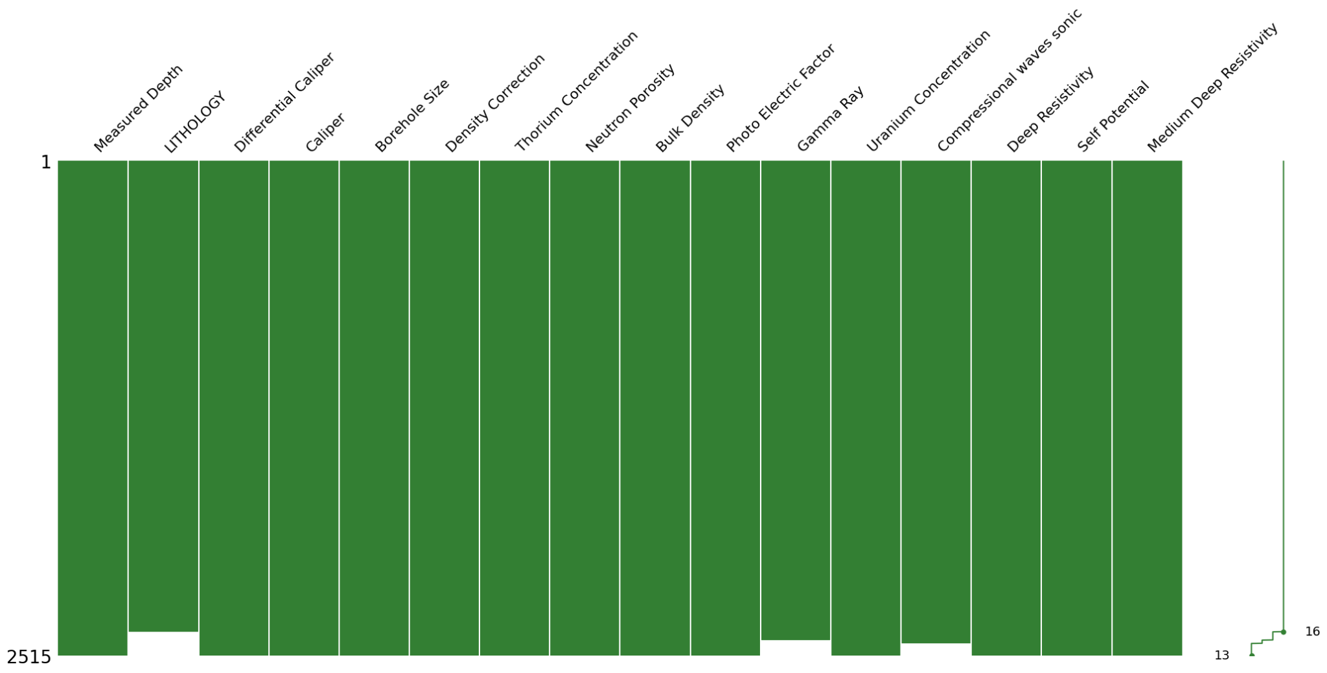
Data Missingness

Slide 6
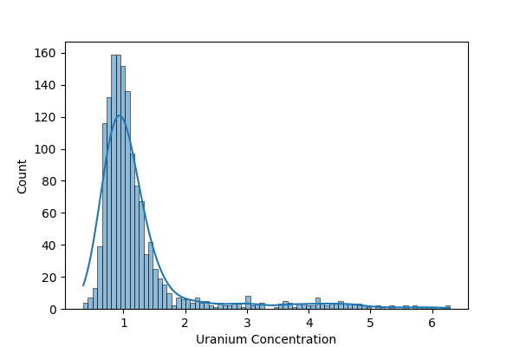
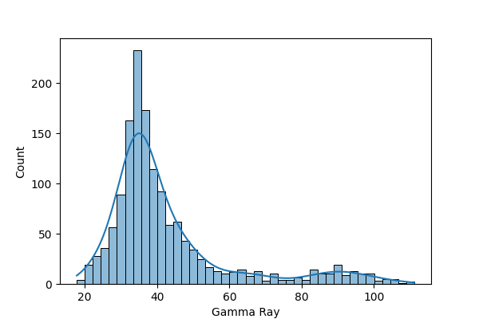
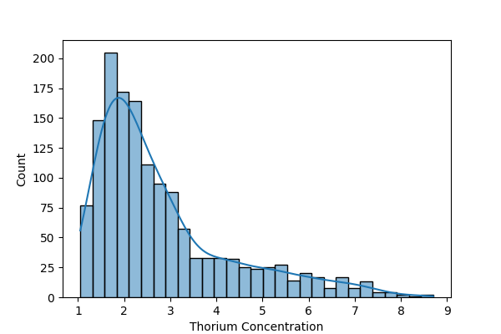
Q1: Reading Distributions

Slide 7
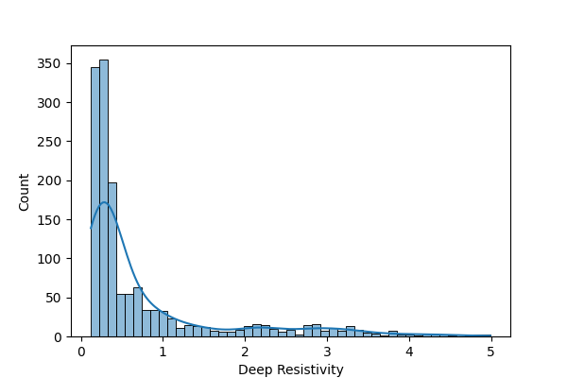
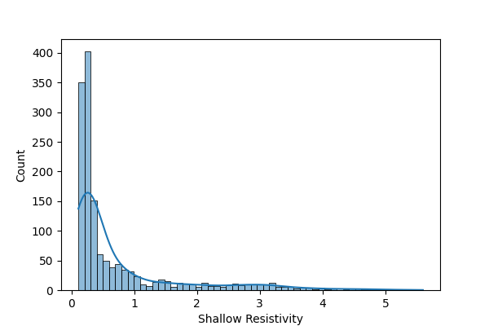
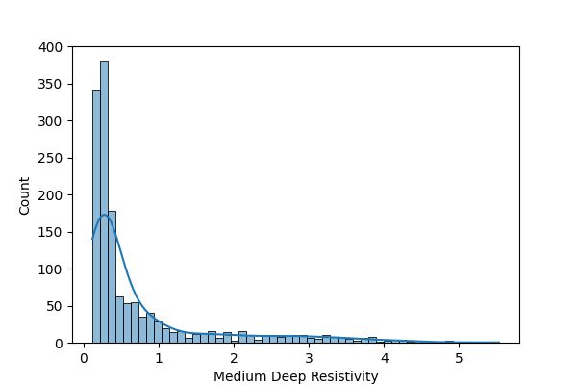
Q1: Reading Distributions

Slide 8
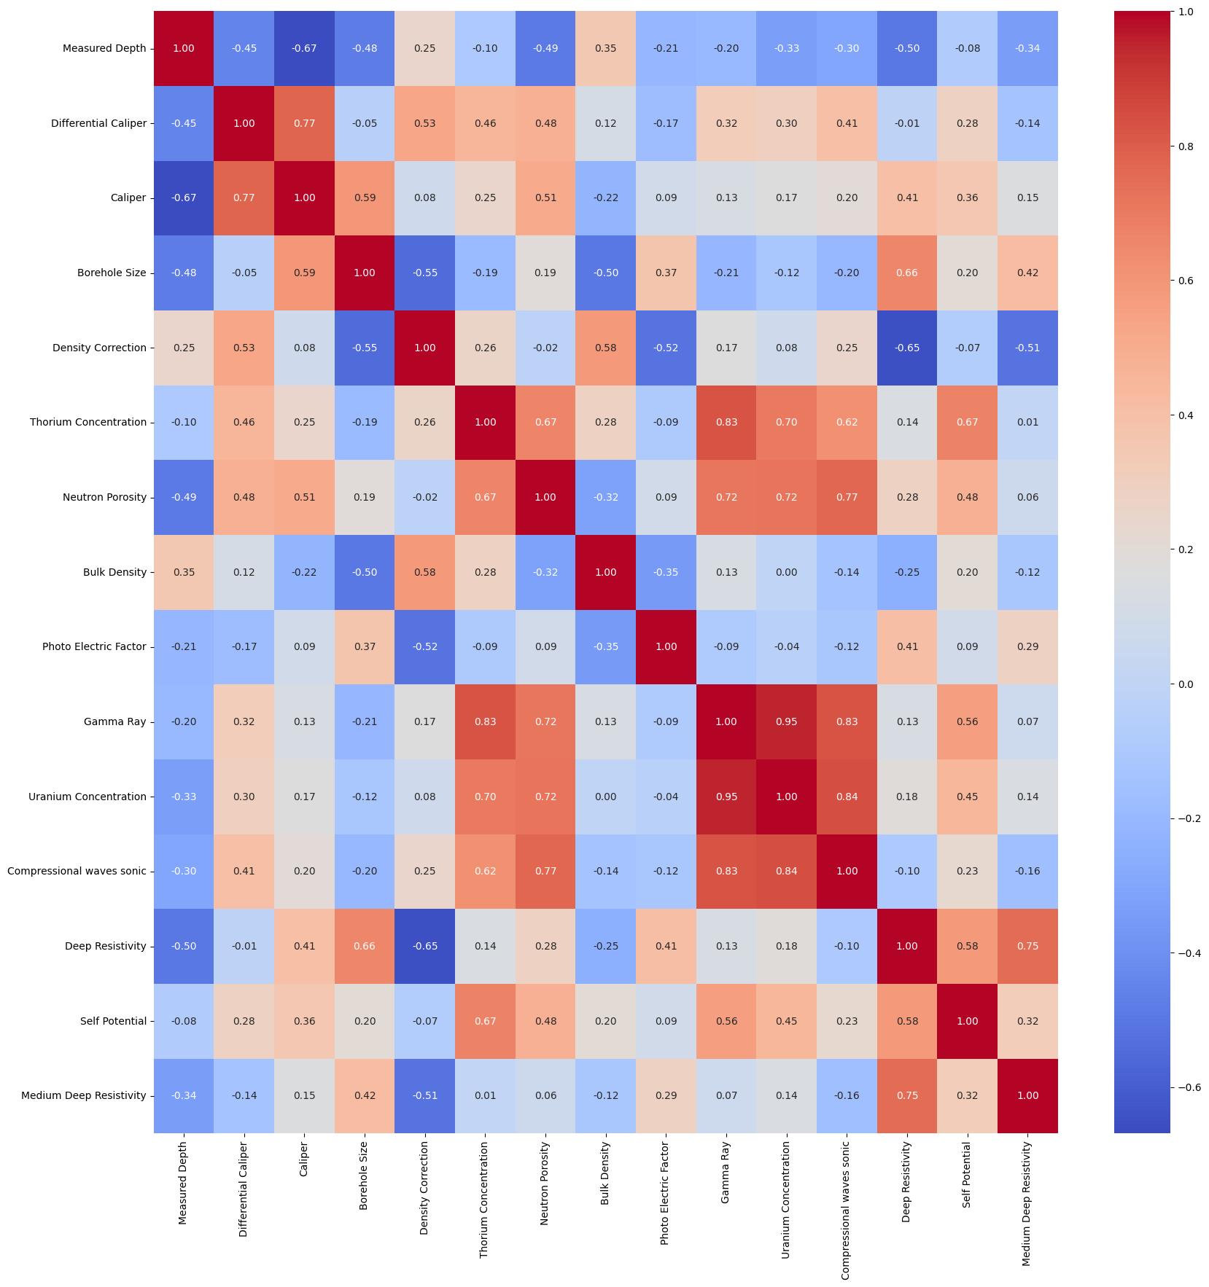
Q2: Correlation Between Readings

Slide 9
Q2: Correlation Between Readings

Slide 10
Q2: Correlation Between Readings
High Correlation Between:
Medium Resistivity & Deep Resistivity
Shallow Resistivity & Deep Resistivity
Gamma Ray & Thorium
Gamma Ray & Uranium
Neutron Porosity & Compressional Sonic
Neutron Porosity & Shear Sonic

Slide 11
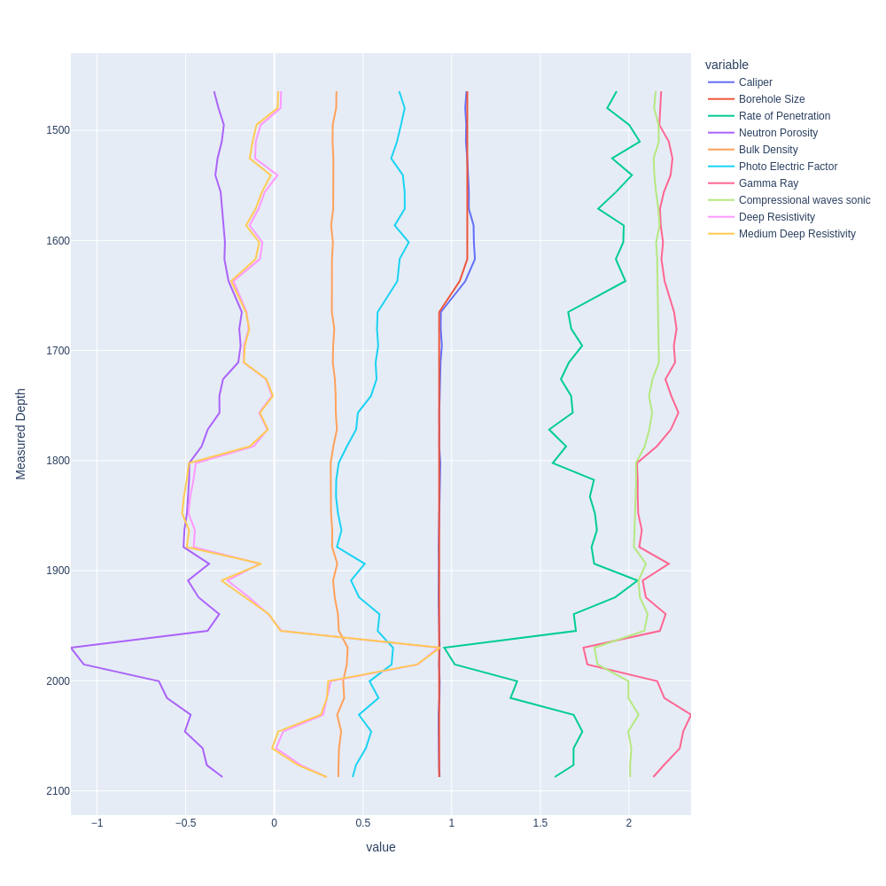
Q3: Sensor Readings VS Depth
Fluctuations at deep points
All readings tend to decrease with depth
Depth is factor affecting the readings
Lithology changes rapidly at lower levels

Slide 12
Q4: Means Of Gamma Rays And Neutron Porosity Test
Null hypothesis: both means of gamma rays and neutron porosity aren’t significantly different in shale and sandstone
Alternative hypothesis: both the means of gamma rays and neutron porosity are significantly different in shale and sandstone
2 Sample t-test: P < 0.05 → Null Hypothesis is Rejected
Tested on different datasets with same result: Alternative Hypothesis is accepted

Slide 13
Q5: Lithology Prediction
Model | Accuracy
Logistic Regression | 0.86
SVC | 0.95
Random Forest | 0.96

Slide 14
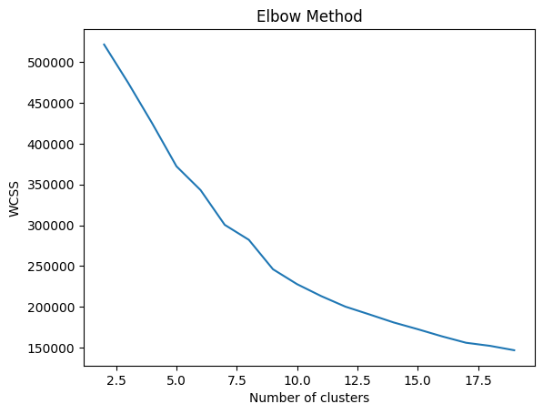
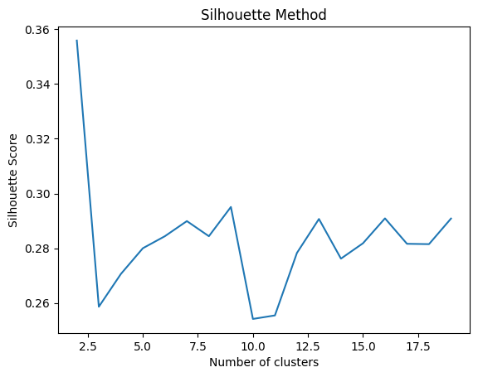
Q6: Lithology Clustering

Slide 15
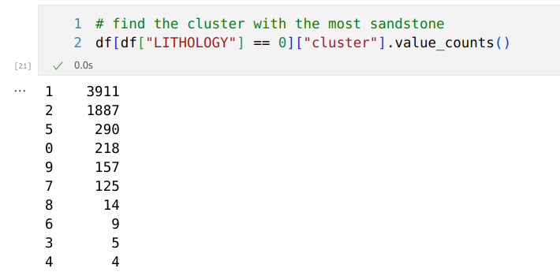
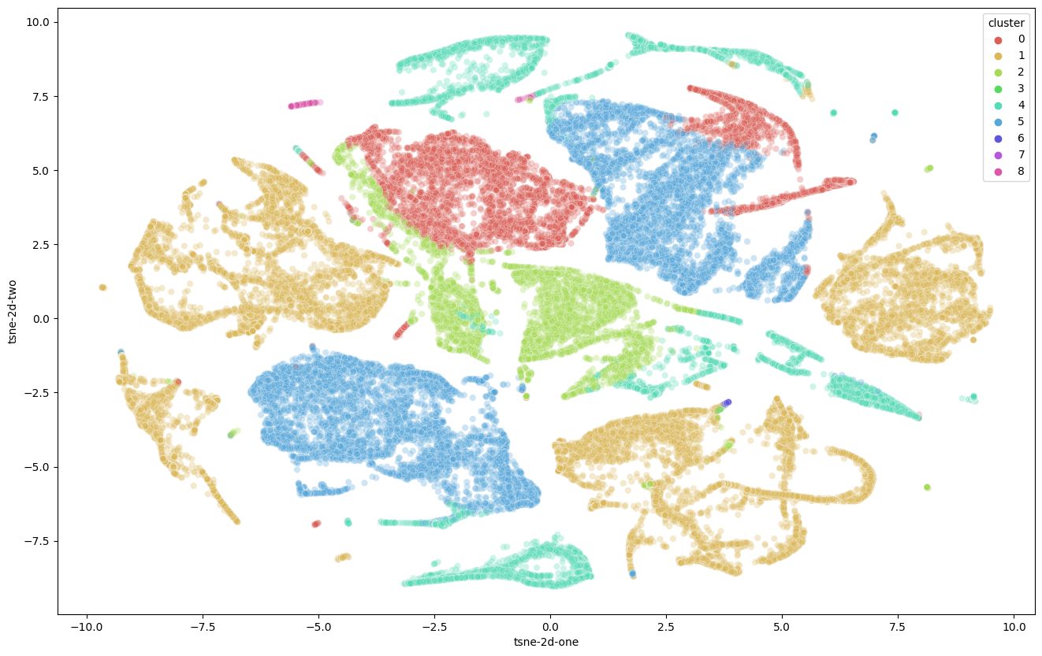
Q6: Lithology Clustering

Slide 16
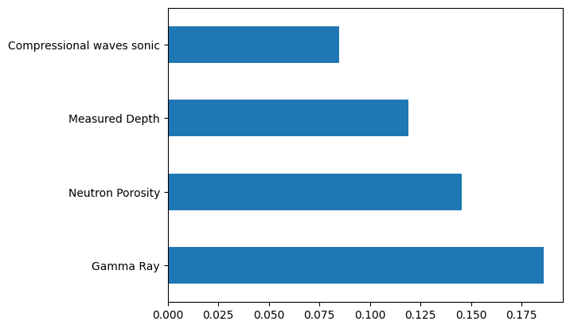
Q7: Feature Selection

Slide 17
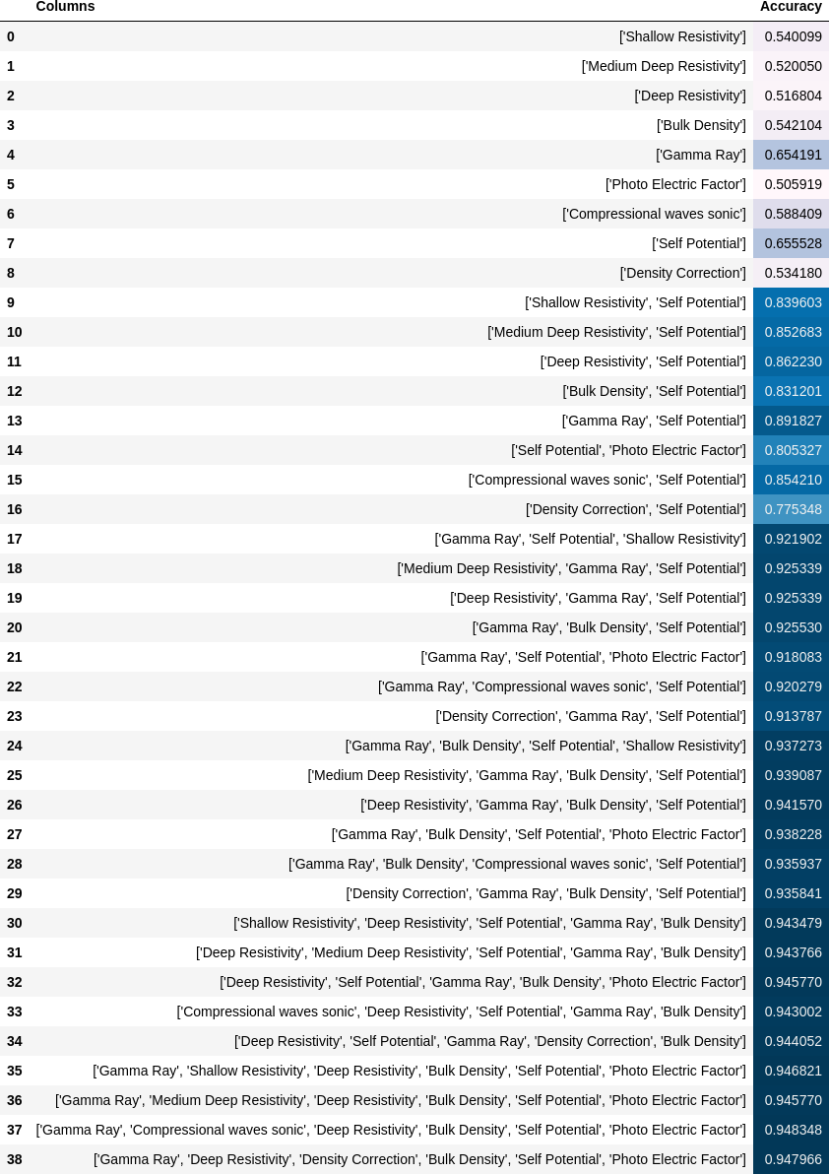
Q7: Feature Selection

Slide 18
Q7: Feature Selection

Slide 19
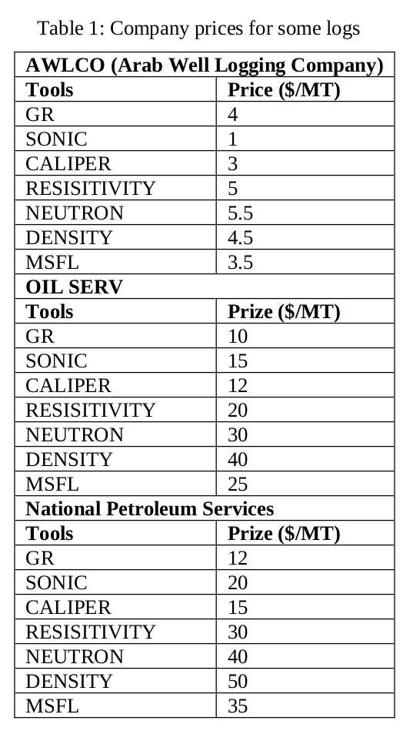
Q7: Feature Selection
Selecting Gamma Ray, Compressional waves sonic, Deep Resistivity, Bulk Density, Self Potential, Photoelectric as the only features
Gives us an accuracy of 0.9483482910063014
Reduces the cost of logging significantly from $75/m. To $30/m..
But this is regarding logging for lithology classification only.

Slide 20
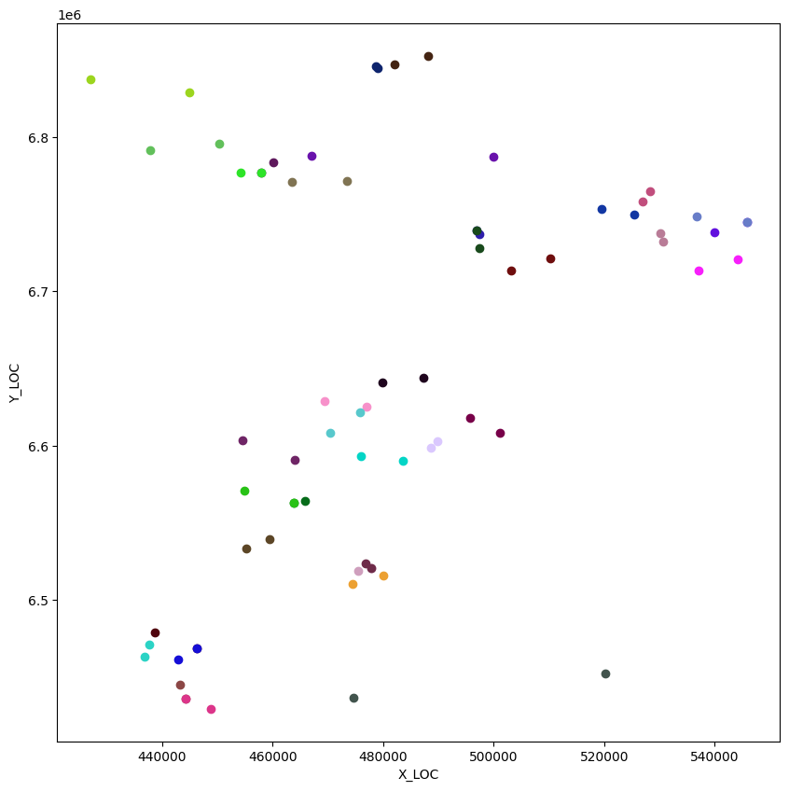
Q8: “Geologists say that geology is not random, however, petroleum engineers say that it is random based on their experience” Test the hypothesis
Null hypothesis: wells close to each other have the same distribution of lithology
Alternative hypothesis: wells lithology is not the same regardless of how close they are to each other
Kolmogorov Smirnov test on each two: Failed to reject the Null hypothesis

Slide 21
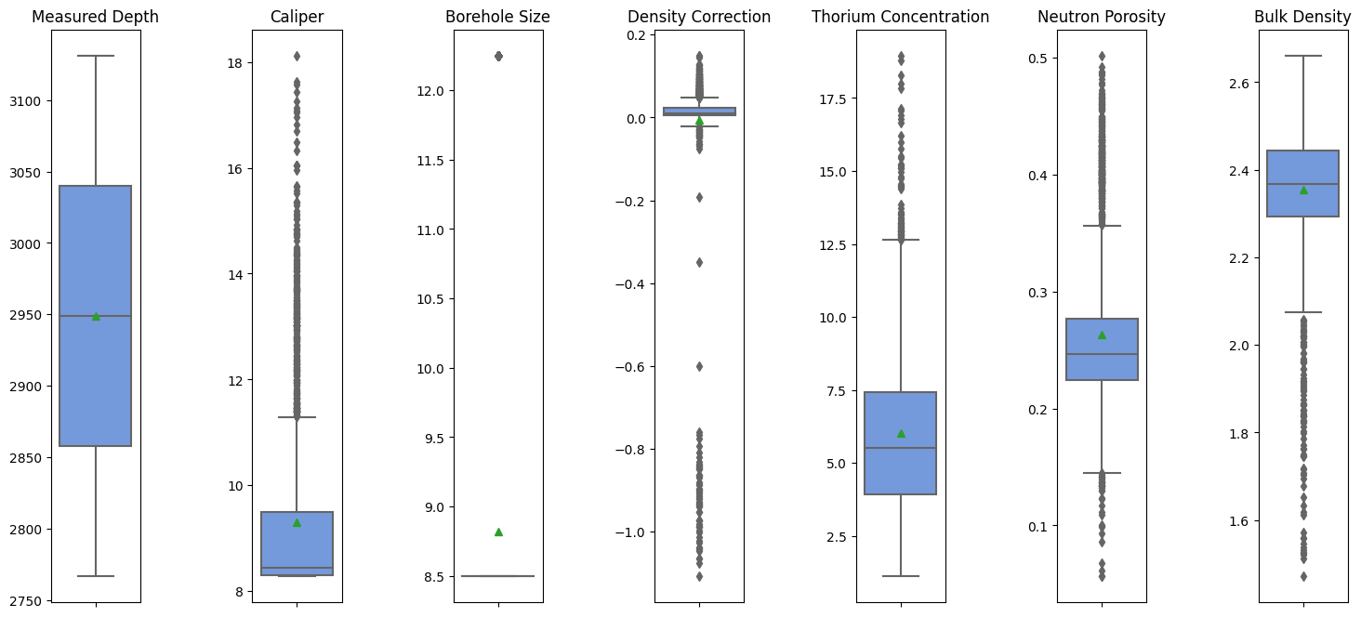
Q9: Anomalies And Information

Slide 22
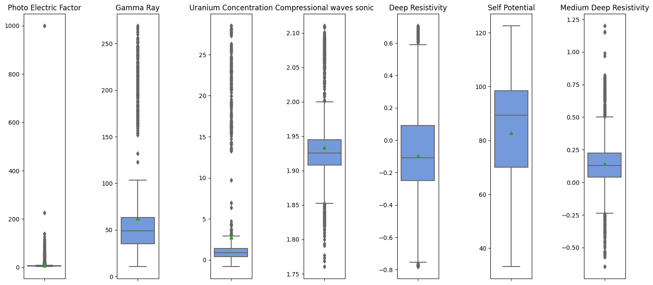
Q9: Anomalies And Information

Slide 23
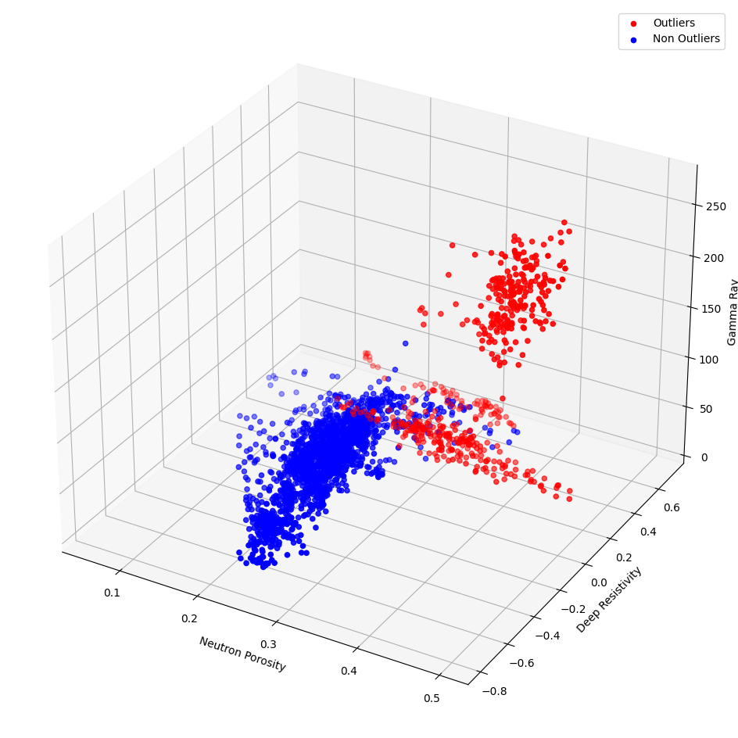
Q9: Anomalies And Information
High resistivity → doesn’t contain water
Low gamma ray → may be sandstone
High Neutron Porosity → not solid

Slide 24
Q10: Where Is The Oil?
Exists in sandstone (for it porosity)
Has low gamma rays
Has high resistivity
Has a crossover between neutron porosity and bulk density

Slide 25
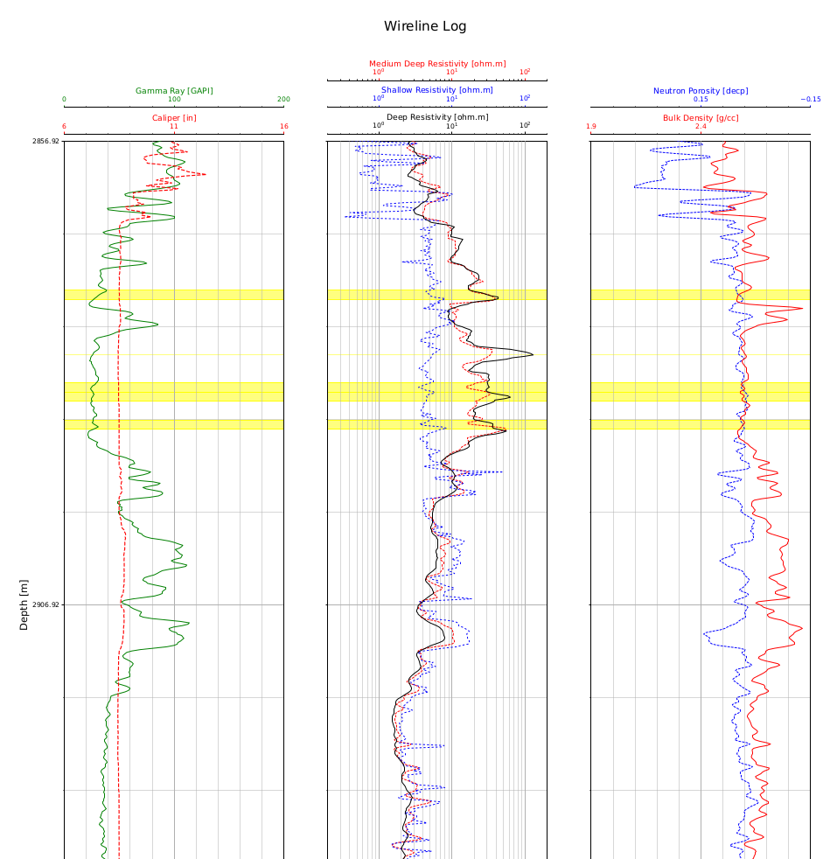

Slide 26
Thank You

